Slide 1
Harnessing the Power of the Web via R Clients for Web APIs
Lucy D’Agostino McGowan, PhD
Johns Hopkins Bloomberg School of Public Health
@LucyStats

Slide 2
Outline
What is an API?

Slide 3
Outline
What is an API?
How are APIs accessed from R

Slide 4
Outline
What is an API?
How are APIs accessed from R
Case studies

Slide 5
Outline
What is an API?
How are APIs accessed from R
Case studies

Slide 6
API

Slide 7
API
application

Slide 8
API
application programming

Slide 9
API
application programming interface

Slide 14
RESTful API
Notes:
A RESTful API is an API that uses HTTP requests to GET, PUT, POST and DELETE data. It is based on representational state transfer technology.

Slide 15
REQUEST via HTTP Methods
HyperText Transfer Protocol

Slide 16
REQUEST via HTTP Methods
HyperText Transfer Protocol
GET
POST
PUT
PATCH
DELETE
Notes:
GET to read or retrieve a resource
POST to create a resource
PUT to update or replace a resource
PATCH to update or modify a resource
DELETE to delete a resource
Sometimes people think of CRUD (create read update delete)
Difference between PUT and PATCH – put is a full replacement of a document, PATCH is a modification

Slide 17
REQUEST via HTTP Methods
GET
POST
PUT
PATCH
DELETE
Notes:
GET to read or retrieve a resource
POST to create a resource
PUT to update or replace a resource
PATCH to update or modify a resource
DELETE to delete a resource
Sometimes people think of CRUD (create read update delete)
Difference between PUT and PATCH – put is a full replacement of a document, PATCH is a modification

Slide 18
REQUEST via HTTP Methods
GET
POST
PUT
PATCH
DELETE
Notes:
GET to read or retrieve a resource
POST to create a resource
PUT to update or replace a resource
PATCH to update or modify a resource
DELETE to delete a resource
Sometimes people think of CRUD (create read update delete)
Difference between PUT and PATCH – put is a full replacement of a document, PATCH is a modification

Slide 19
REQUEST via HTTP Methods
GET
POST
PUT
PATCH
DELETE
Notes:
GET to read or retrieve a resource
POST to create a resource
PUT to update or replace a resource
PATCH to update or modify a resource
DELETE to delete a resource
Sometimes people think of CRUD (create read update delete)
Difference between PUT and PATCH – put is a full replacement of a document, PATCH is a modification

Slide 20
REQUEST via HTTP Methods
GET
POST
PUT
PATCH
DELETE
Notes:
GET to read or retrieve a resource
POST to create a resource
PUT to update or replace a resource
PATCH to update or modify a resource
DELETE to delete a resource
Sometimes people think of CRUD (create read update delete)
Difference between PUT and PATCH – put is a full replacement of a document, PATCH is a modification

Slide 21
REQUEST via HTTP Methods
GET
POST
PUT
PATCH
DELETE
Notes:
GET to read or retrieve a resource
POST to create a resource
PUT to update or replace a resource
PATCH to update or modify a resource
DELETE to delete a resource
Sometimes people think of CRUD (create read update delete)
Difference between PUT and PATCH – put is a full replacement of a document, PATCH is a modification

Slide 22
HTTP Methods

Slide 23
Choose Method

Slide 24
Built a set of urls that return data

Slide 25
Built a set of urls that return data

Slide 26
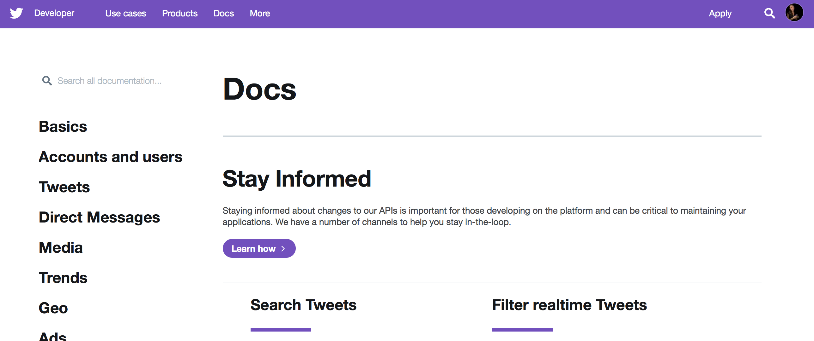
Built a set of urls that return data
https://developer.twitter.com/en/docs.html

Slide 27
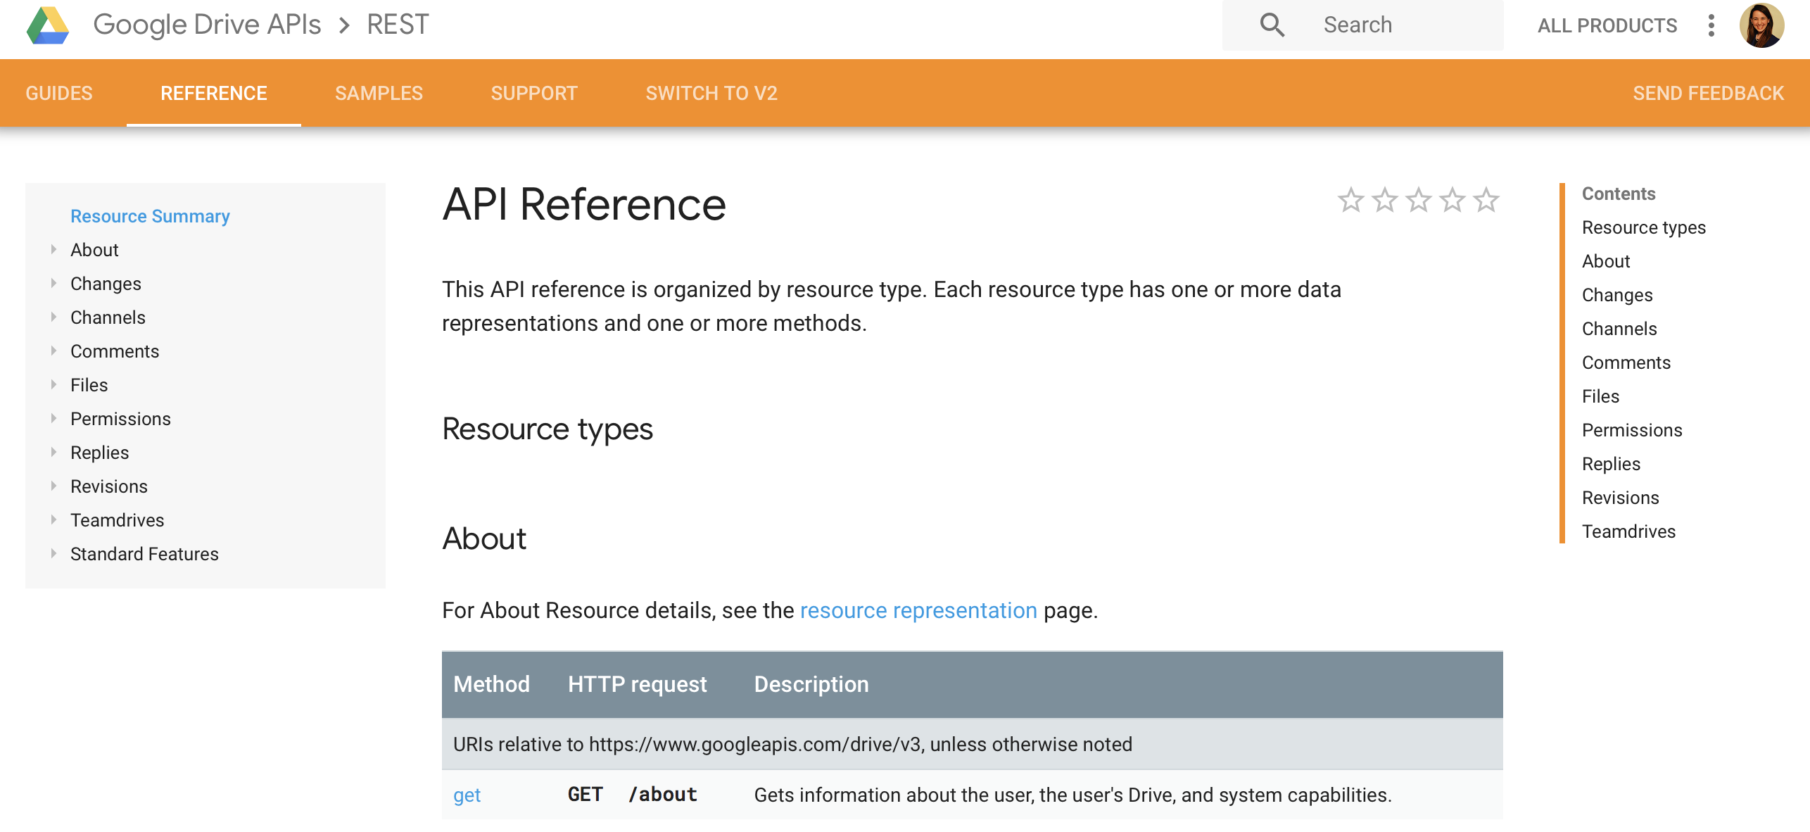
Built a set of urls that return data
https://developers.google.com/drive/api/v3/reference/
https://developer.twitter.com/en/docs.html

Slide 28
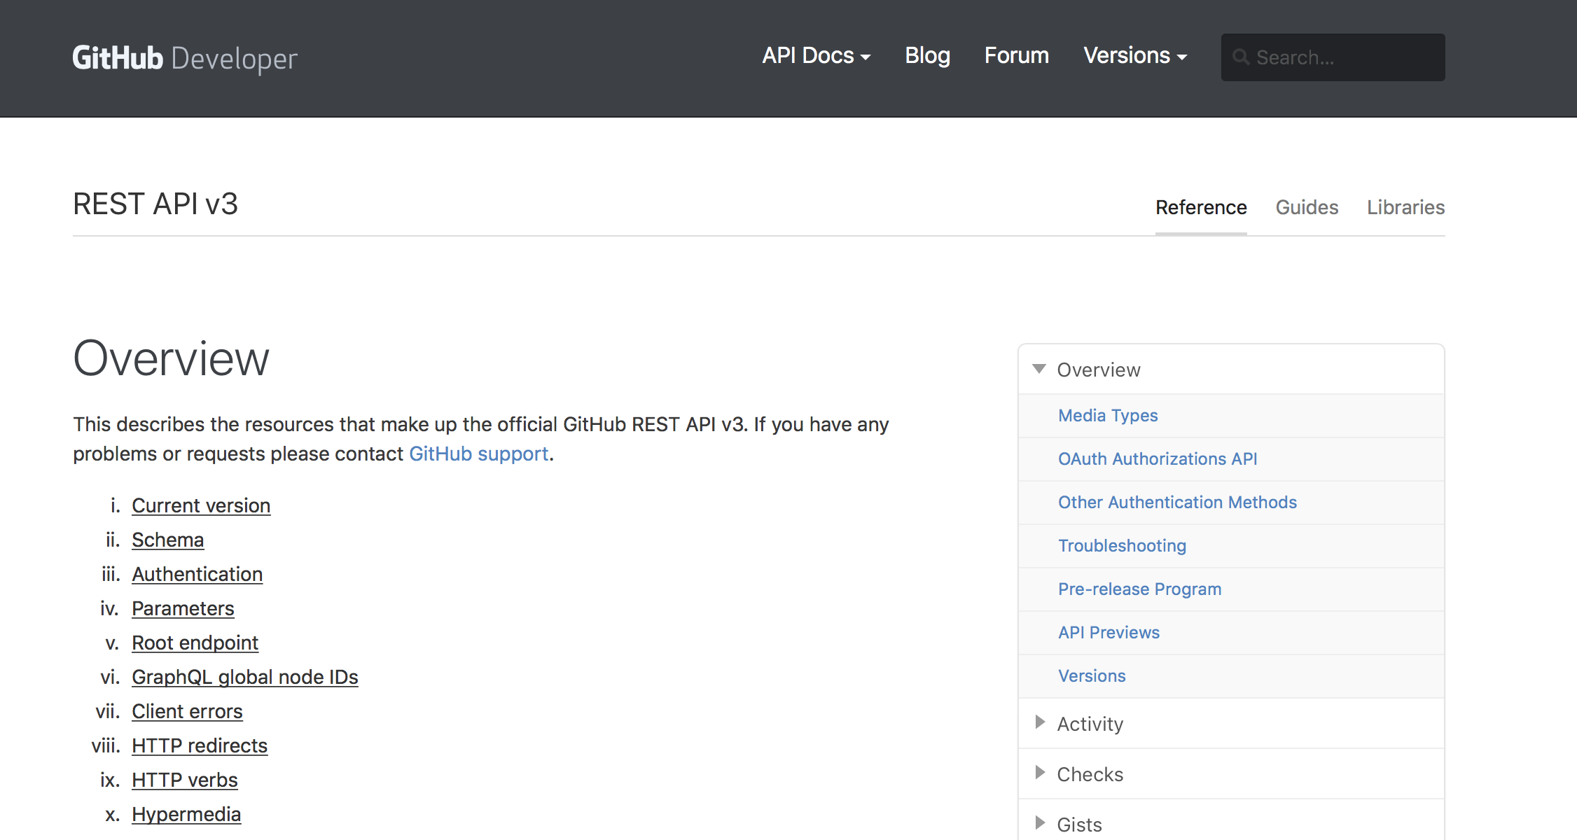
Built a set of urls that return data
https://developer.github.com/v3/
https://developers.google.com/drive/api/v3/reference/
https://developer.twitter.com/en/docs.html

Slide 29
Built a set of urls that return data

Slide 30
Built a set of urls that return data, often JSON

Slide 31
JSON
JavaScript

Slide 32
JSON
JavaScript Object

Slide 33
JSON
JavaScript Object Notation

Slide 34
according to json.org
light weight data-interchange format
JSON

Slide 35
according to json.org
light weight data-interchange format
easy for humans to read / write
JSON

Slide 36
according to json.org
light weight data-interchange format
easy for humans to read / write
easy for computers to parse /
generate
JSON

Slide 37
﻿[
{
"statuses": {
"created_at": "Thu Jul 19 21:45:08 +0000 2018",
"id": 1020062005892470000,
"id_str": "1020062005892468738",
"full_text": "Our team are looking forward to meeting all the @AmstatNews attendees in Vancouver next week #JSM2018 #Vancouver #Canada https://t.co/XiOrCtuUOk",
. . .
}
}
]
JSON

Slide 38
﻿[
{
"statuses": {
"created_at": "Thu Jul 19 21:45:08 +0000 2018",
"id": 1020062005892470000,
"id_str": "1020062005892468738",
"full_text": "Our team are looking forward to meeting all the @AmstatNews attendees in Vancouver next week #JSM2018 #Vancouver #Canada https://t.co/XiOrCtuUOk",
. . .
}
}
]
name
JSON

Slide 39
﻿[
{
"statuses": {
"created_at": "Thu Jul 19 21:45:08 +0000 2018",
"id": 1020062005892470000,
"id_str": "1020062005892468738",
"full_text": "Our team are looking forward to meeting all the @AmstatNews attendees in Vancouver next week #JSM2018 #Vancouver #Canada https://t.co/XiOrCtuUOk",
. . .
}
}
]
name
value
JSON

Slide 40
HTTP Methods
JSON

Slide 41
Choose Method
Build URL

Slide 42
HTTP Methods
JSON
Notes:
Sometimes you don’t need any proof of who you are, like to just access a public website, or for certain “endpoints”

Slide 43
OAuth
Notes:
These go in the authorization header

Slide 44
OAuth
Open

Slide 45
OAuth
Open Authorization
Notes:
Oauth was first released in 2007 as an authentication method for the Twitter API. Basically it gives users the ability to grant third-party access to web resources without sharing a password. It is designed specifically to work with HTTP. It gives an access token that can be used to access resources. These are somewhat preferable to API keys because they expire.

Slide 46
Choose Method
Build URL
Get Authorization

Slide 47
Outline
What is an API?
How are APIs accessed from R
Case studies

Slide 48
httr

Slide 49
Choose Method
Build URL
Get Authorization
Make Request
Process Response

Slide 50
Choose Method
Build URL
Get Authorization
Make Request
Process Response

Slide 51
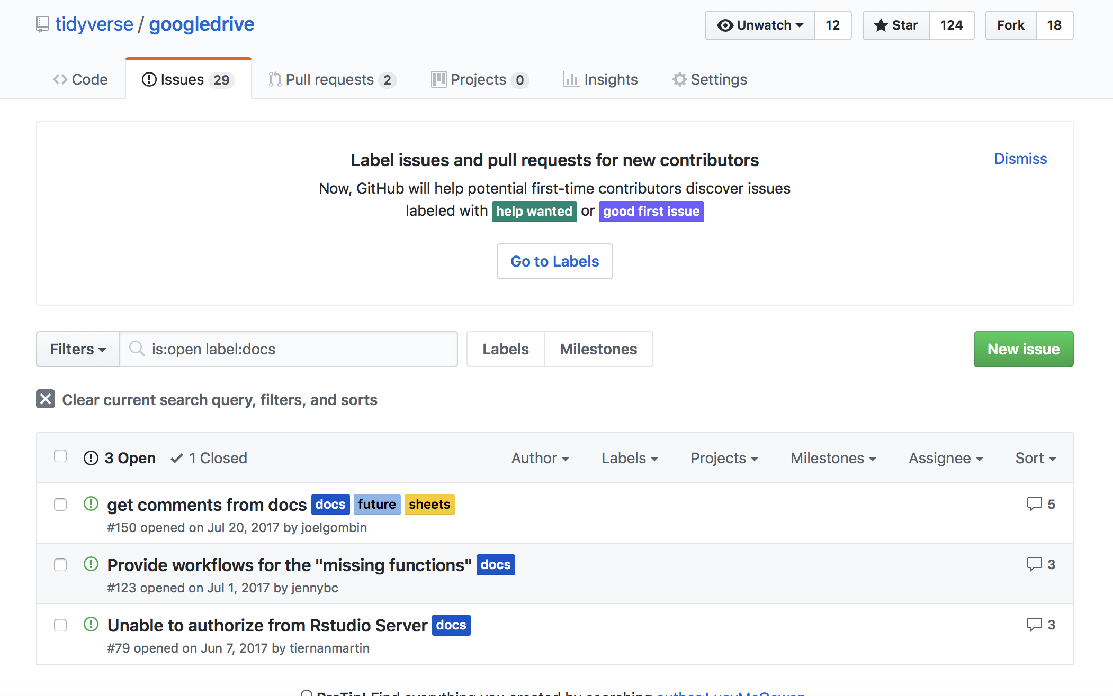

Slide 52
REQUEST via HTTP Methods
GET
POST
PUT
PATCH
DELETE
httr::GET()
httr::POST()
httr::PUT()
httr::PATCH()
httr::DELETE()

Slide 53
REQUEST via HTTP Methods
GET
POST
PUT
PATCH
DELETE
httr::GET()
httr::POST()
httr::PUT()
httr::PATCH()
httr::DELETE()

Slide 54
Choose Method
Build URL
Get Authorization
Make Request
Process Response

Slide 55
https://api.github.com/repos/tidyverse/googledrive/issues?labels=docs
library(httr)
url <- modify_url(
url = "https://api.github.com/",
path = "repos/tidyverse/googledrive/issues",
query = list(labels = "docs")
)
BUILD URL

Slide 56
base URL
https://api.github.com/repos/tidyverse/googledrive/issues?labels=docs
library(httr)
url <- modify_url(
url = "https://api.github.com/",
path = "repos/tidyverse/googledrive/issues",
query = list(labels = "docs")
)
BUILD URL

Slide 57
base URL
endpoint
https://api.github.com/repos/tidyverse/googledrive/issues?labels=docs
library(httr)
url <- modify_url(
url = "https://api.github.com/",
path = "repos/tidyverse/googledrive/issues",
query = list(labels = "docs")
)
BUILD URL

Slide 58
base URL
endpoint
parameters
https://api.github.com/repos/tidyverse/googledrive/issues?labels=docs
library(httr)
url <- modify_url(
url = "https://api.github.com/",
path = "repos/tidyverse/googledrive/issues",
query = list(labels = "docs")
)
BUILD URL

Slide 59
Choose Method
Build URL
Get Authorization
Make Request
Process Response

Slide 60
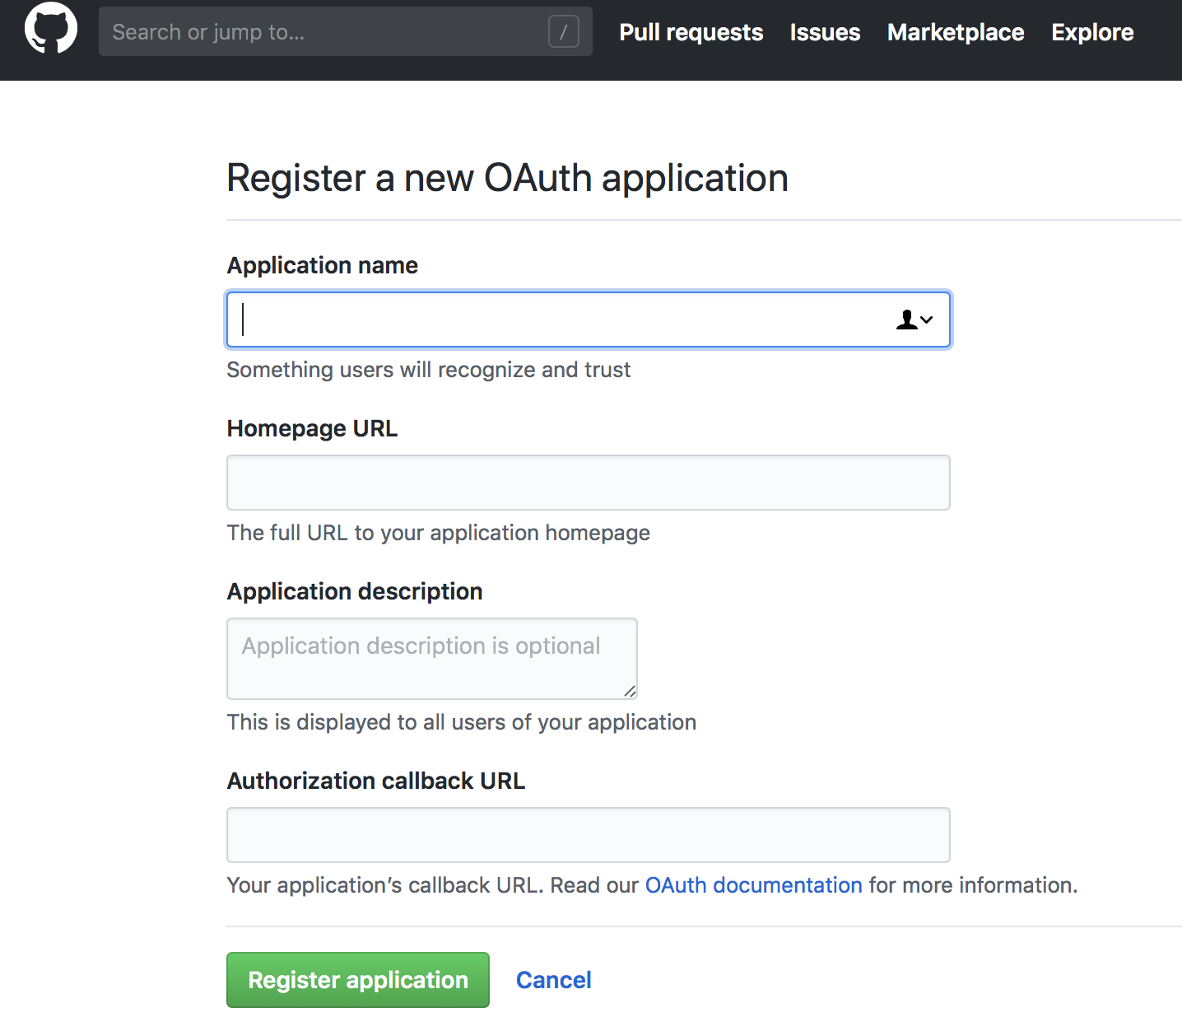
Authentication
1
Register an application
https://github.com/settings/developers
Notes:
I am going to focus on Oauth – API keys are a bit easier, as you can just send the string

Slide 61
Authentication
Register an application
Create an OAuth application
1
2
library(httr)
app <- oauth_app(
appname = "NAME",
key = "KEY",
secret = "SECRET"
)
https://github.com/settings/developers
Notes:
I am going to focus on Oauth – API keys are a bit easier, as you can just send the string

Slide 62
Authentication
Register an application
Create an OAuth application
Generate a token
1
2
3
library(httr)
app <- oauth_app(
appname = "NAME",
key = "KEY",
secret = "SECRET"
)
token <-
oauth2.0_token(
oauth_endpoints("github"),
app
)
https://github.com/settings/developers
Notes:
Here we are using oauth2.0_token, there is also 1.0. (like or twitter) (Google, Facebook, Github all use 2.0) The httr package has plenty of demos for different cases.

Slide 63
Authentication
Register an application
Create an OAuth application
Generate a token
1
2
3
library(httr)
app <- oauth_app(
appname = "NAME",
key = "KEY",
secret = "SECRET"
)
token <-
oauth2.0_token(
oauth_endpoints("github"),
app
)
https://github.com/settings/developers
Notes:
Here we are using oauth1.0_token, there is also 2.0. (Google, Facebook, Github all use 2.0) The httr package has plenty of demos for different cases.

Slide 64
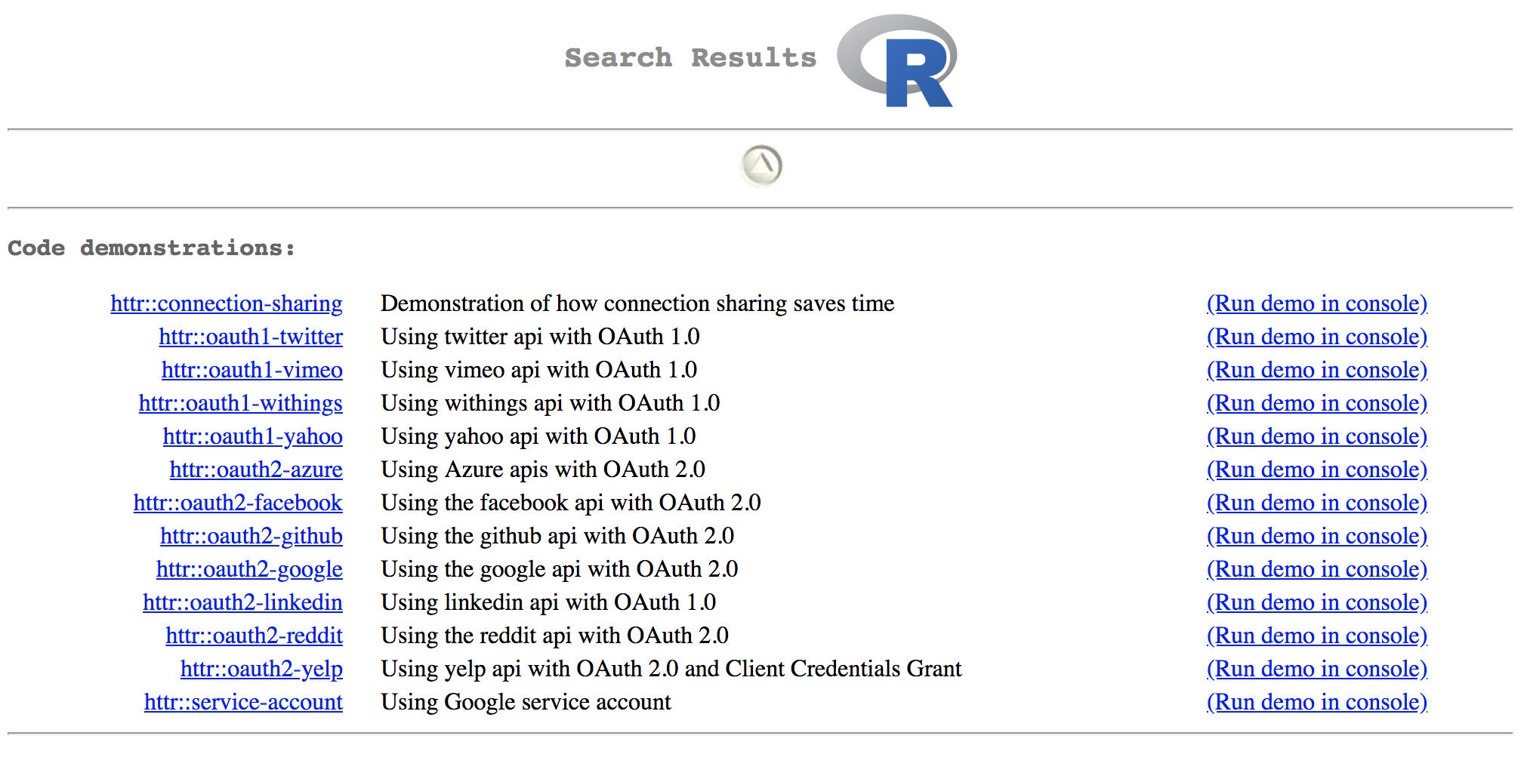

Slide 65
Choose Method
Build URL
Get Authorization
Make Request
Process Response

Slide 66
library(httr)
req <- GET(url, config = token)
REQUEST

Slide 67
library(httr)
req <- GET(url, config = token)
req
#> Response
#> [https://api.github.com/repos/tidyverse/googledrive/issues?labels=docs]
#> Date: 2018-07-20 14:35
#> Status: 200
#> Content-Type: application/json; charset=utf-8
#> Size: 86.6 kB
#> [
#> {
#> "url": "https://api.github.com/repos/tidyverse/googledrive/issues/150",
#> "repository_url": "https://api.github.com/repos/tidyverse/googledrive",
#> ...
REQUEST

Slide 68
library(httr)
req <- GET(url, config = token)
req
#> Response
#> [https://api.github.com/repos/tidyverse/googledrive/issues?label=docs]
#> Date: 2018-07-20 14:35
#> Status: 200
#> Content-Type: application/json; charset=utf-8
#> Size: 86.6 kB
#> [
#> {
#> "url": "https://api.github.com/repos/tidyverse/googledrive/issues/150",
#> "repository_url": "https://api.github.com/repos/tidyverse/googledrive",
#> ...
REQUEST
Notes:
This part should look familiar, it’s that JSON we discussed in the first section. In it’s current form, req is an object of class “response” we need to process it to be able to actually do anything with it.

Slide 69
Choose Method
Build URL
Get Authorization
Make Request
Process Response

Slide 70
library(httr)
req <- GET(url, config = token)
res <- content(req)
PROCESS
Notes:
For that we use the content function. This will parse the content of the request.

Slide 71
library(httr)
req <- GET(url, config = token)
res <- content(req)
res
#> [[1]]
#> [[1]]$url
#> [1] "https://api.github.com/repos/tidyverse/googledrive/issues/150"
#>
#> [[1]]$repository_url
#> [1] "https://api.github.com/repos/tidyverse/googledrive"
PROCESS
Notes:
For that we use the content function. This will parse the content of the request.

Slide 72
library(httr)
req <- GET(url, config = token)
res <- content(req)
res
#> [[1]]
#> [[1]]$url
#> [1] "https://api.github.com/repos/tidyverse/googledrive/issues/150"
#>
#> [[1]]$repository_url
#> [1] "https://api.github.com/repos/tidyverse/googledrive"
PROCESS

Slide 73
library(httr)
req <- GET(url, config = token)
res <- content(req)
purrr::map_chr(res, "url")
PROCESS

Slide 74
library(httr)
req <- GET(url, config = token)
res <- content(req)
purrr::map_chr(res, "url")
#> [1] "https://api.github.com/repos/tidyverse/googledrive/issues/150"
#> [2] "https://api.github.com/repos/tidyverse/googledrive/issues/123"
#> [3] "https://api.github.com/repos/tidyverse/googledrive/issues/79"
PROCESS
Notes:
For that we use the content function. This will parse the content of the request.

Slide 75
Choose Method
Build URL
Get Authorization
Make Request
Process Response

Slide 76
gh
rtweet
googledrive
googlesheets
yelpr
meetupr
imugR
aws.*
Notes:
There are a bunch of aws packages from cloudyr for various functions.

Slide 77
library(googledrive)
drive_ls()

Slide 78
library(googledrive)
drive_ls()
#> Waiting for authentication in browser...
#> Press Esc/Ctrl + C to abort

Slide 79
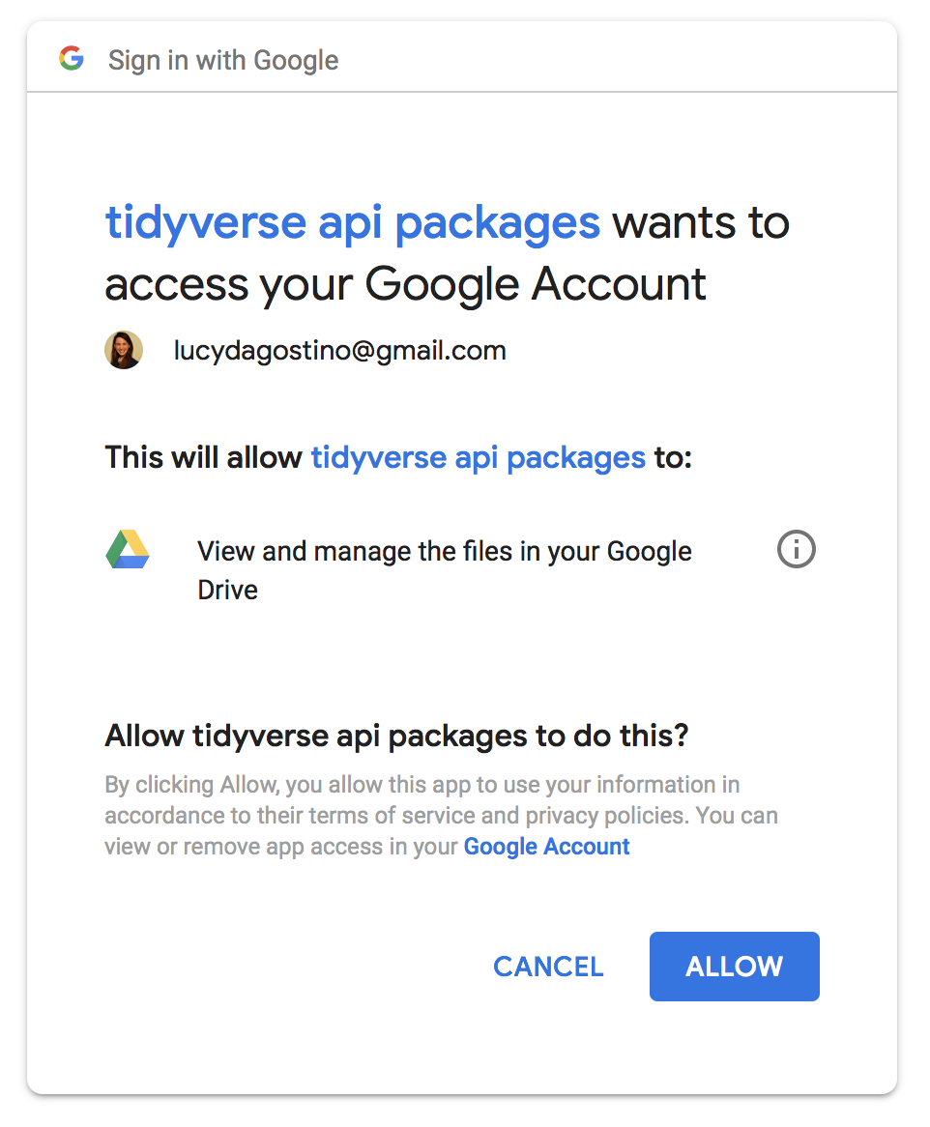

Slide 80
library(googledrive)
drive_ls()
#> Waiting for authentication in browser...
#> Press Esc/Ctrl + C to abort
#> Authentication complete.
#> Items so far:
#> 200 300 400 500 600 700 800 900 1000 1100 1200 1300 1400 1500 1600 1670
#> # A tibble: 1,670 x 3
#> name id drive_resource
#> * <chr> <chr> <list>
#> 1 data.zip 1ET81D_Uku6Tm_Z4U04jB4qTNrC… <list [37]>
#> 2 science_manuscript 10X07LsQI5GL_Tdrq3-3PtgcDtW… <list [31]>
#> 3 talks 12bBwImIu4Yzg5UaqcvxIZ0rbyG… <list [31]>
#> 4 presentations 1-PItelqpv0Sb_LdiEDqb8O3D_R… <list [32]>
#> 5 science_supplementary_materials 1JNogHk0Zn-H5je6a-DBh0muwBW… <list [31]>
#> 6 iris-collaboration-analysis-plan 10DrdHfxyPFTuACKO5YqcpFrcPM… <list [32]>
#> 7 2018-07-16_meeting-minutes 1oUAPeFSvVfo5BBoeCip-2kuOup… <list [32]>
#> 8 p-hack-athon.Rda 1cwgv9GkrgcVEImxcKSni-Tdf-B… <list [32]>
#> 9 rladies-pres 1-cSy2GqNumuD2YpeIOG_Tv2aQ-… <list [33]>
#> 10 Women in Statistics 1ZRK0Bonakg_qkg5McU7Lr9fpDx… <list [30]>
#> # ... with 1,660 more rows

Slide 81
Outline
What is an API?
How are APIs accessed from R
Case studies

Slide 82
Upload my slides to drive
library(googledrive)
drive_upload("2018-07_jsm/slides.pptx",
path = "postdoc/talks/",
name = "2018-07_jsm_slides",
type = "presentation")

Slide 83
Organize my drive from the comfort of my console
library(googledrive)
leek_files <- drive_find(q = "'jtleek@gmail.com' in writers")
postdoc_folder <- drive_mkdir("postdoc")
purrr::walk(leek_files$id,
~drive_mv(as_id(.x), path = postdoc_folder)
)

Slide 84
Organize my drive from the comfort of my console
library(googledrive)
leek_files <- drive_find(q = "'jtleek@gmail.com' in writers")
postdoc_folder <- drive_mkdir("postdoc")
purrr::walk(leek_files$id,
~drive_mv(as_id(.x), path = postdoc_folder)
)

Slide 85
Organize my drive from the comfort of my console
library(googledrive)
leek_files <- drive_find(q = "'jtleek@gmail.com' in writers")
postdoc_folder <- drive_mkdir("postdoc")
purrr::walk(leek_files$id,
~drive_mv(as_id(.x), path = postdoc_folder)
)

Slide 86
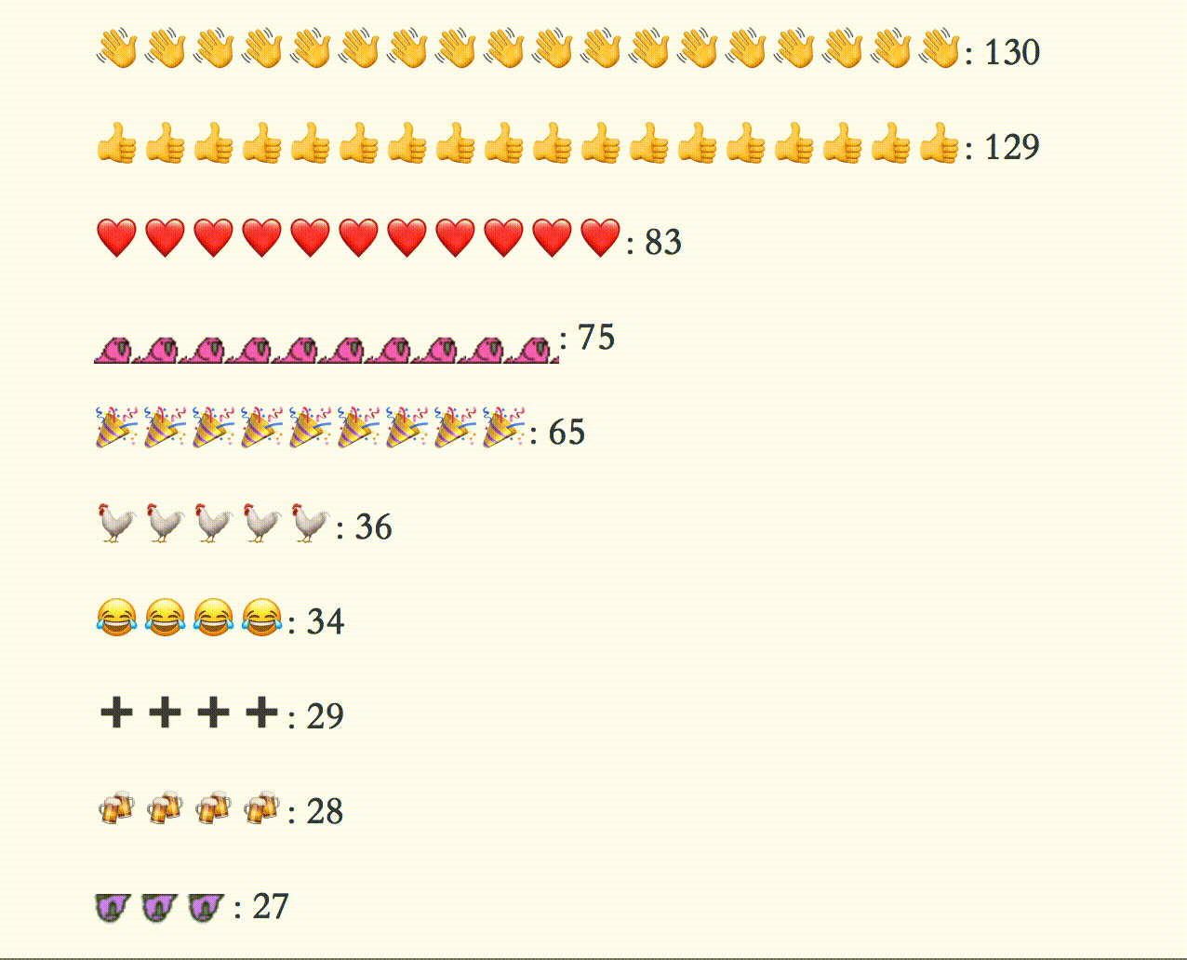
Pulling most frequent Slack Emoji
http://livefreeordichotomize.com/2017/07/17/ropensci-slack-emojis/

Slide 87
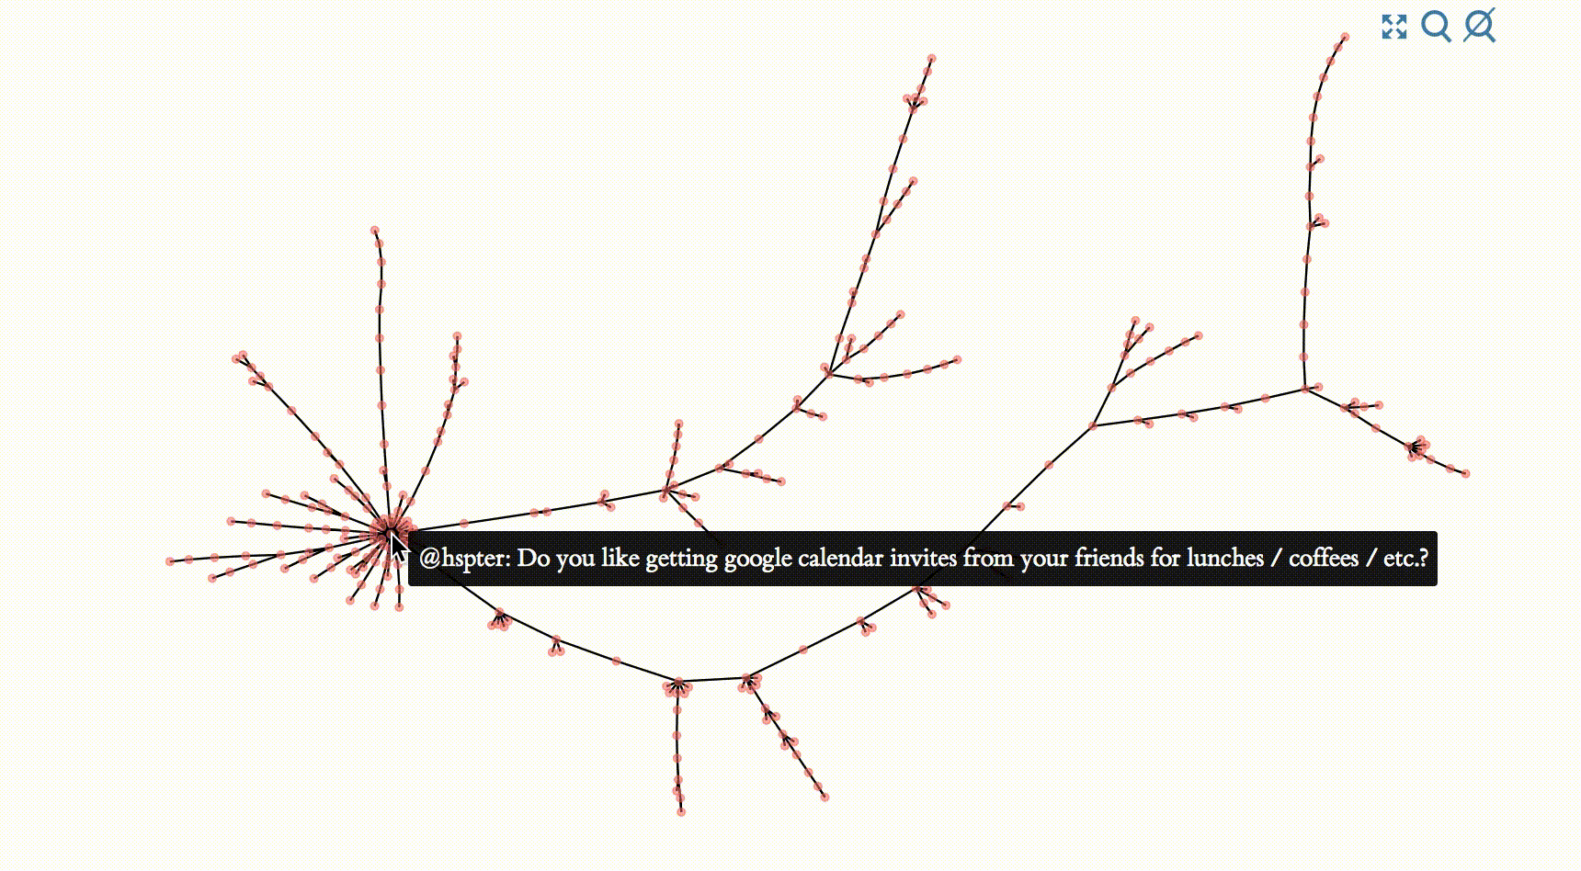
Navigating Twitter Responses
http://livefreeordichotomize.com/2017/07/24/twitter-trees/

Slide 88
We R Ladies
http://livefreeordichotomize.com/2017/07/18/the-making-of-we-r-ladies/
Notes:
Used the meetupr package to pull profile pictures of everyone in an R-Ladies group

Slide 89
@LucyStats bit.ly/lucystats-jsm2018 lucydagostino@gmail.com
Thank you!
Harnessing the Power of the Web via R Clients for Web APIs
Lucy D’Agostino McGowan, PhD
Johns Hopkins Bloomberg School of Public Health

